Slide 1
Document Management
Human Resources
Scanning/Laserfische
Credentials
Technology
Sub-Finder
CODESP
Accounting
GASB45/Revenue Limit/Mandated Costs
Disaster Recovery
Benefits Management
SharePoint
QSS
Position Control-Payroll-Budget
Fiber Networks- Connecting your Schools
School
Business
State of the Governors Budget
Optimizing Your Lab Infrastructure
QCC
Finance - Grant /Pupil Accounting
Payroll
Risk Management
Preventing School Arson
Retirement
STRS/PERS
Purchasing- PO Routing
Absence Tracking
Office 2007
Fixed Assets
QCC
Excel
Word
QSS
Integrated Resources Seminar
QCC Absence Tracking Upload

Slide 2
Presenter Information
Name: Allen Tang
Title: Application Support Analyst
Email: allen_tang@sccoe.org
Phone: (408) 453-6748 (Help Desk)
Notes:
Talk about Help Desk
Provide address if they promise to send money.

Slide 3
Goal of this Seminar
Set your upload Sheets
Upload absences
Error Checking
Verification
Notes:
Districts use many different methods: Cards, homegrown databases, spreadsheets
Today: present an approach that will allow you to integrate this process with QSS.
Absence Tracking is its own module
Exists on its own function link in QCC (so you can set security accordingly)

Slide 4
Benefits
Integration!
Ease of Use
Sychronization
Notes:
Putting the pieces together…. Perhaps, this is a piece of the puzzle that you were missing.
Reports
One central location where absences are managed
Ease of Use - One screen allows you to see all the absence information for an employee.

Slide 5
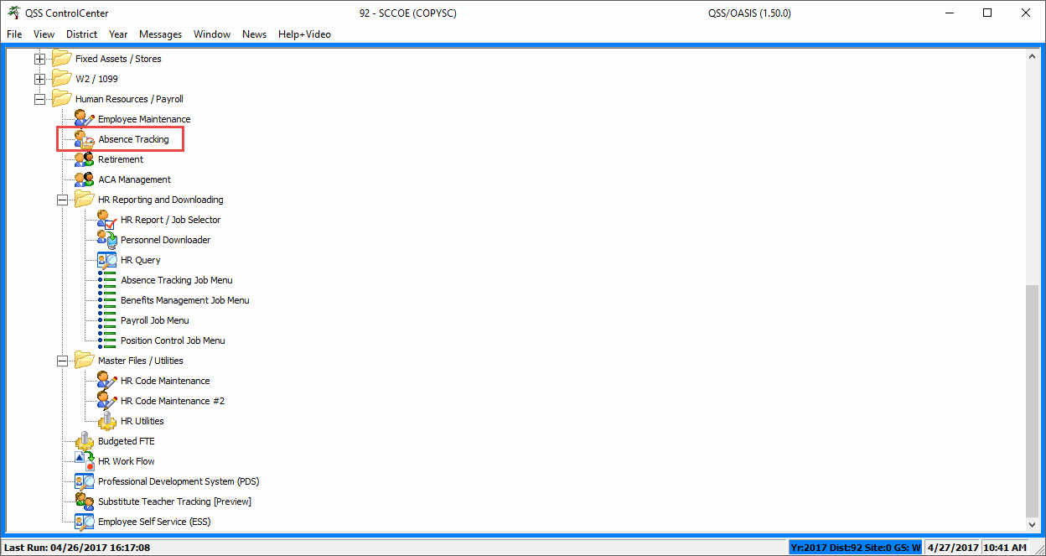
Absence Tracking

Slide 6
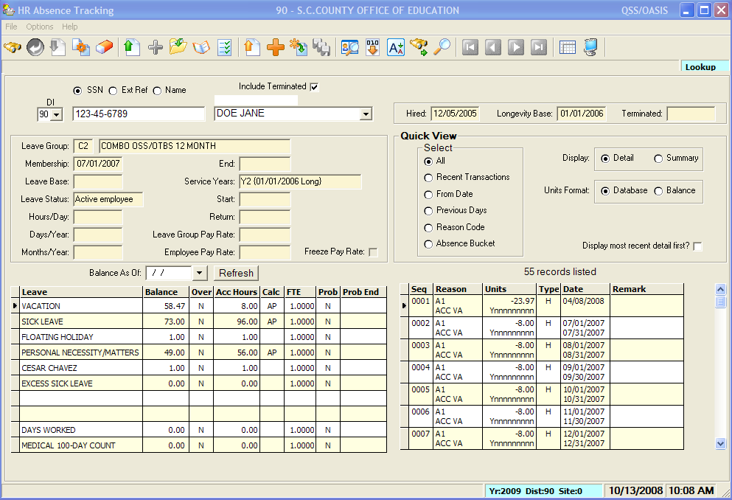
QCC Absence Tracking Screen
Notes:
You can access the Absence Tracking screen by SSN, Ext. Ret. # or Name.
On the main screen you have access to the balance information, the leave transactions and you can look at a summary view or detail view.
You have options to look at a snapshot of balances as of a specific date. And you can gridify each area into Excel.

Slide 7
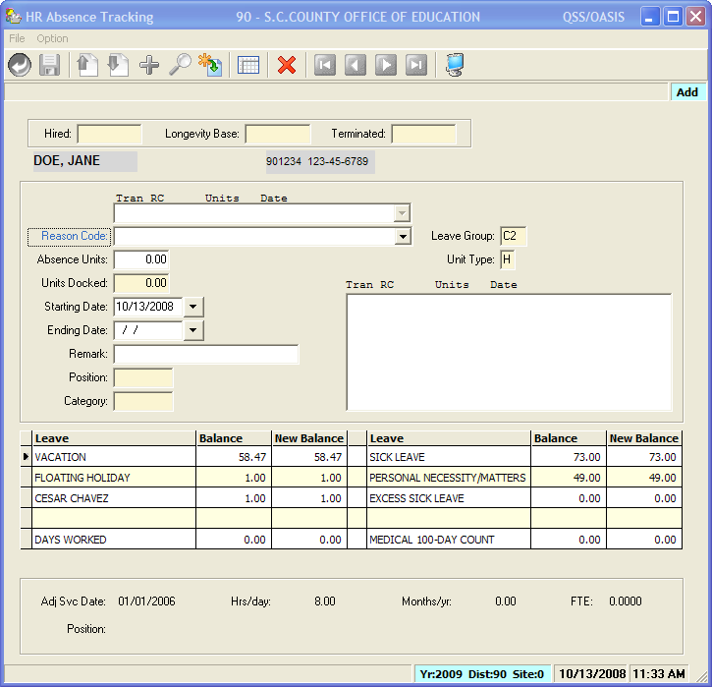
Absence Tracking
Add Screen
Notes:
This screen allows you to add an individual absence transaction for a person.

Slide 8
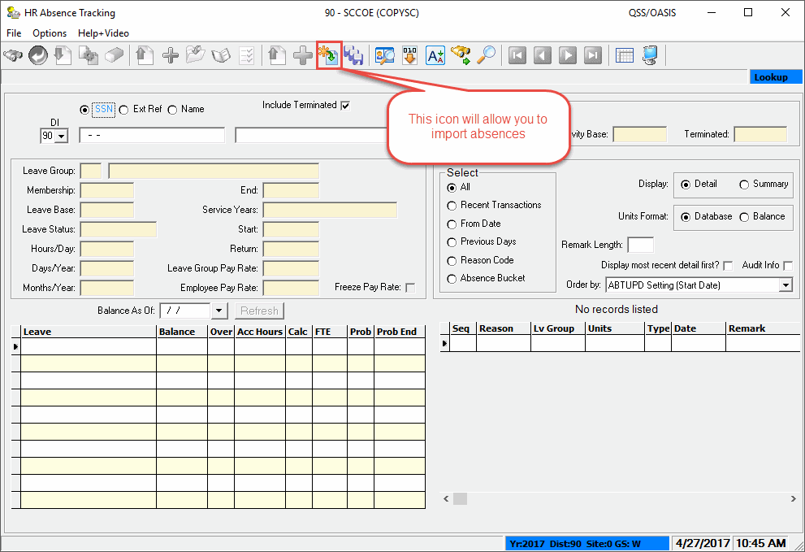
Absence Tracking
Import Function
Notes:
The Change screen allows you to make changes. This should be done for correctional purposes mainly.

Slide 9
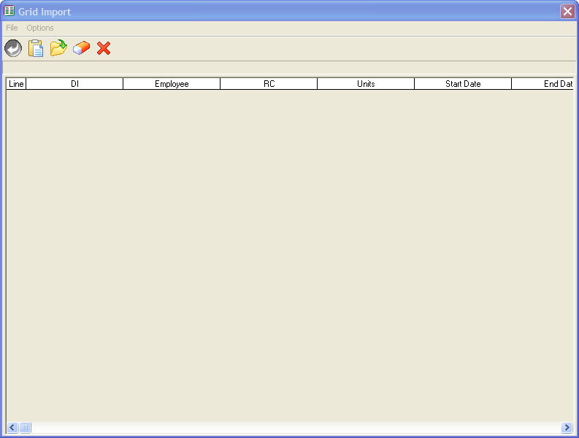
Import Screen
Select File to be uploaded after clicking on open folder
Notes:
You can import information from say a time keeping system.

Slide 10
Upload Sheet
Sheet can be excel or CSV file
Sheet headers are optional as there is an option to remove headers when uploading
District number, Employee ID OR SSN, Leave Reason, Units, Start Date, End date, Remark are headers and are required to be entered in that order.
Notes:
You have the ability to do an advanced search to find a group of people you want to process at one time.

Slide 11
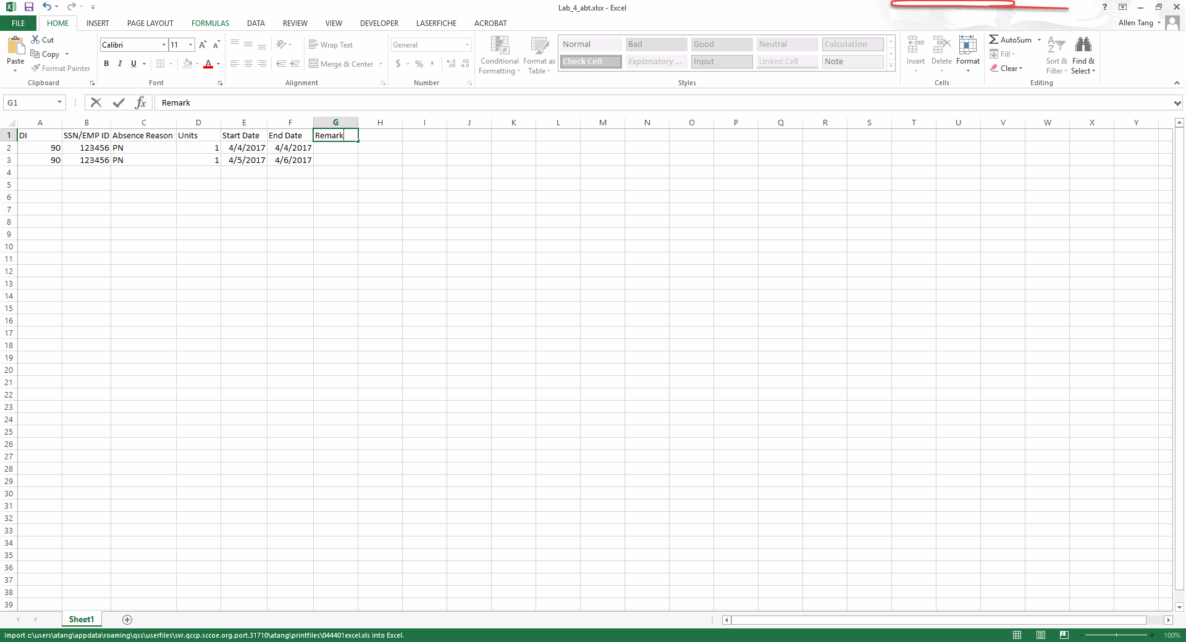
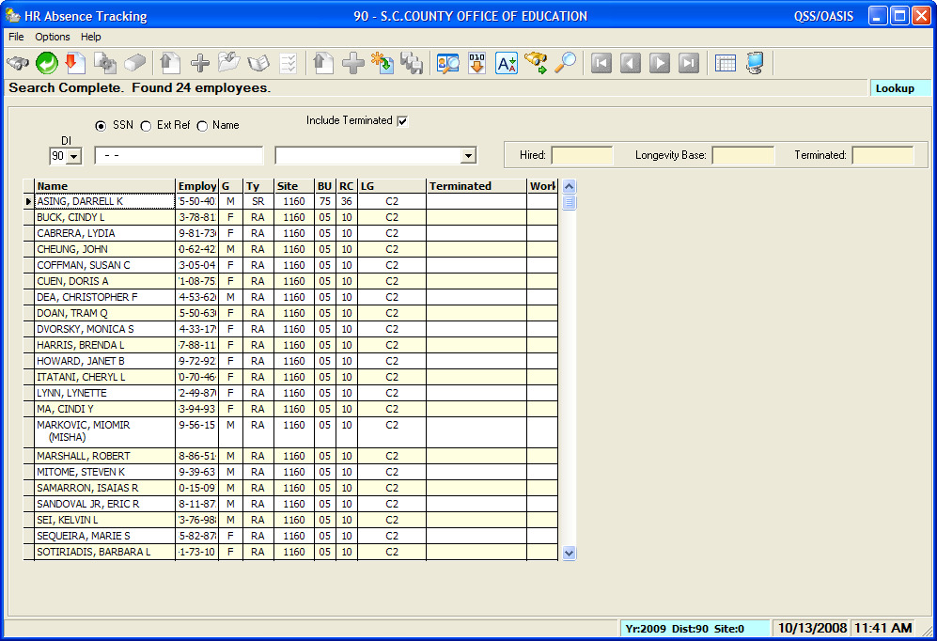
Example of a Sheet
Double-click to bring up Absence Tracking window
Notes:
.

Slide 12
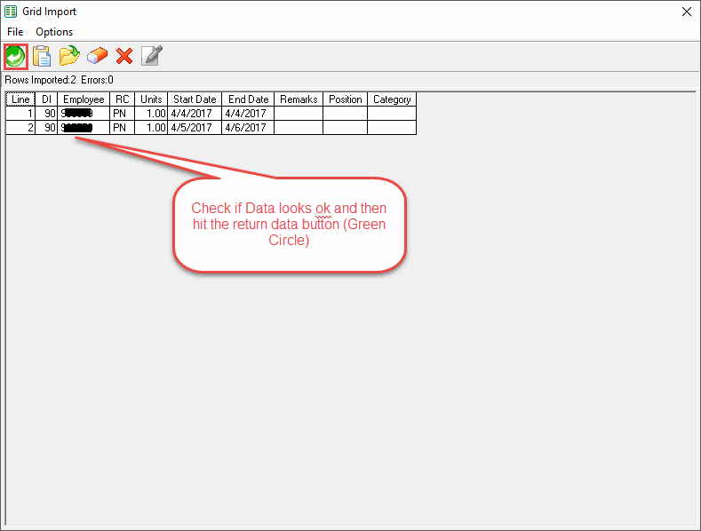
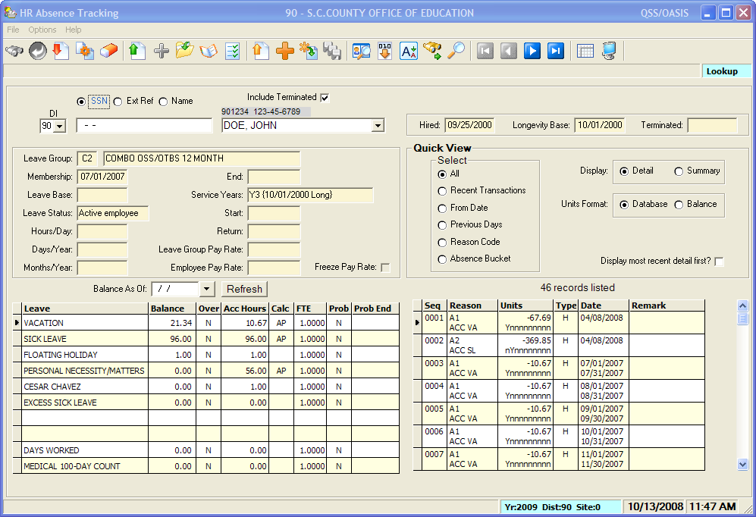
Grid Import

Slide 13
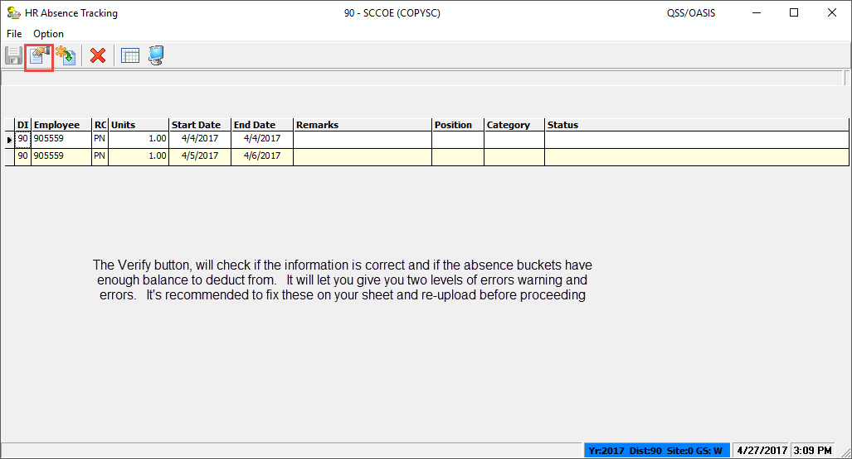
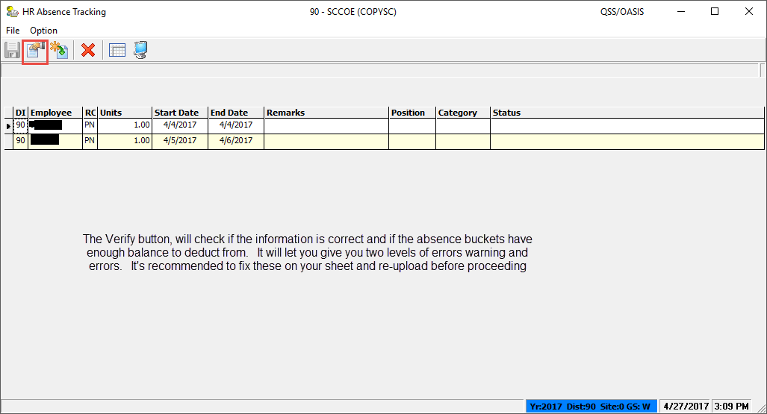
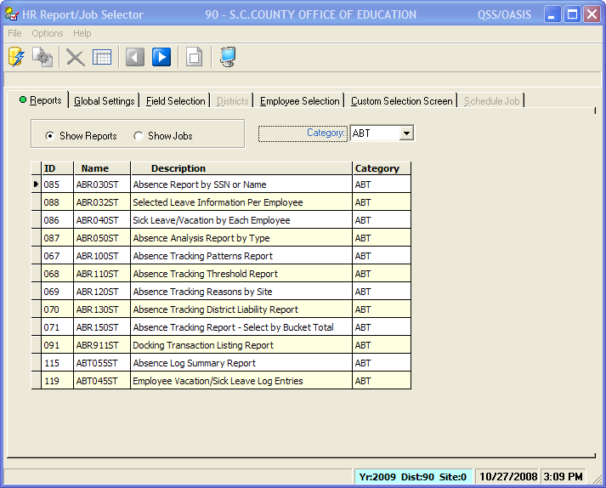
Verify Data

Slide 14
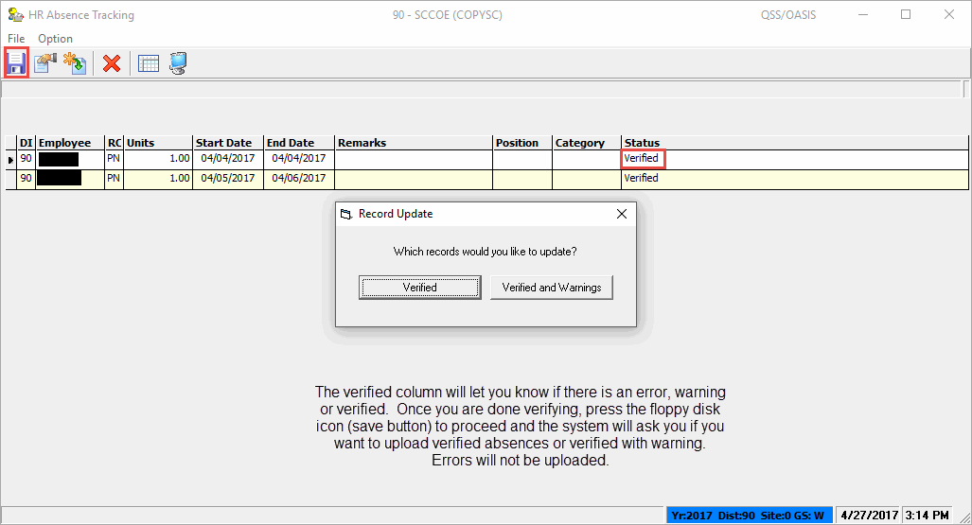
Final Upload

Slide 15
Summary
Using Absence Tracking Uploadwill:
  Save time
  Keep your records up to date
It only takes 3 steps!
Notes:
We’ve covered the basic areas of the Absence Tracking module.
Implementing Absence tracking will help your district integrate their systems and allow for valuable reporting.
And set only takes 3 steps!

Slide 16

Questions?

Slide 17

Let’s put the pieces together!
Thank you for attending!

